Slide 1
LINE SEGMENTATION ON BANLA HANDWRITTEN DOCUMENT IMAGE
By
Hiranya Debsingha
Supervised by Prof. Kaushik Roy
Department of computer science
West Bengal State University

Slide 2
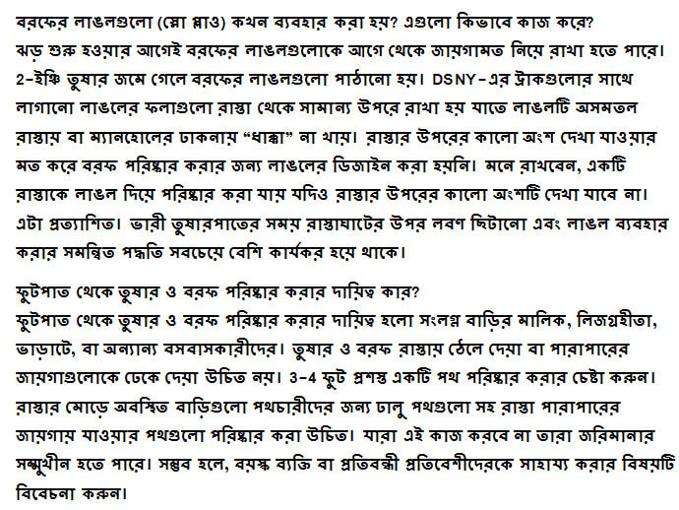
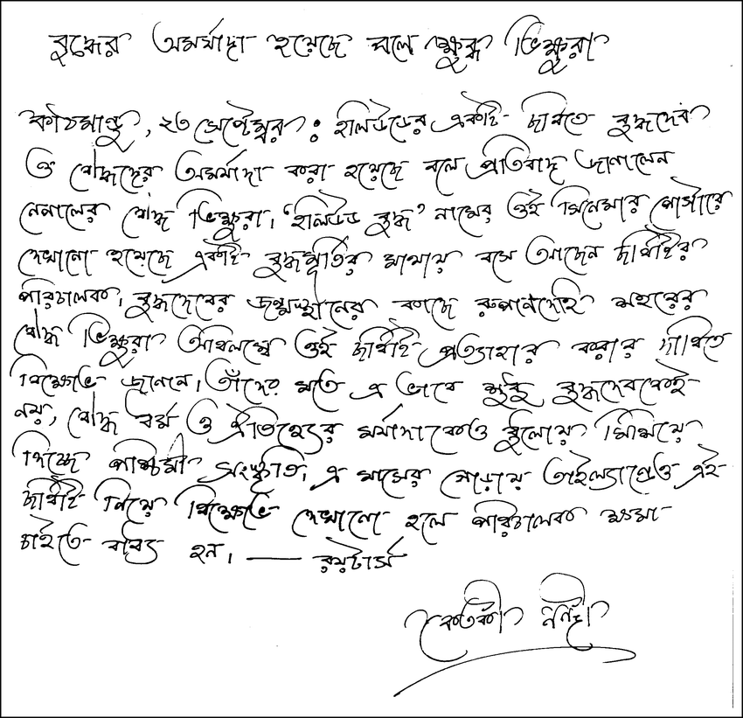
Introduction
Line segmentation is precursor of OCR(Optical Character Recognition)
Design OCR engines are focused on hand "printed" (written in capital letters) text.
1. Print Document 2.Handwritten Document

Slide 3



Why Line Segmentation?
Things get more complicated when we consider Indic script like Bangla which contain modified and compound characters along with isolated character like..
compound character other form of character

Slide 4
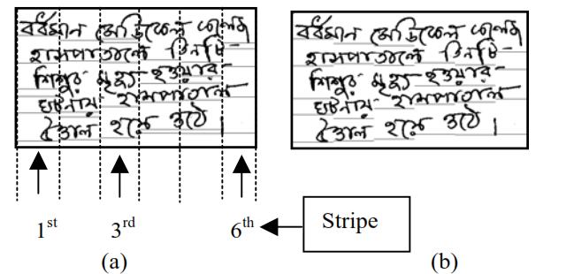
Previous Works (1)
Proposed Approach
  Divide the text into vertical stripes and determine horizontal histogram projections of these stripes

Slide 5
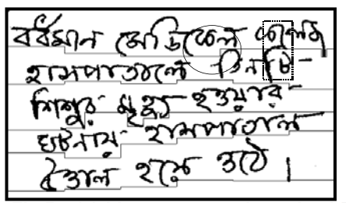
Previous Works(1)
Disadvantages
  Line segmented result of Fig. (a). Text line separation is shown by solid line. Here overlapping portion is marked by circle and touching portion is marked by dotted rectangle.

Slide 6
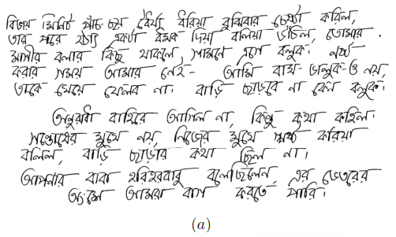
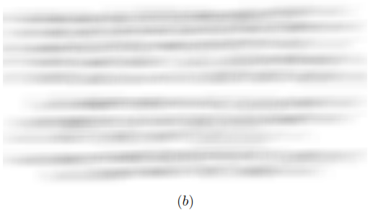
Previous Works(2)
Proposed Approach
  smudge the input document image, to blur-out white spaces between words, while preserving gaps between consecutive lines.

Slide 7
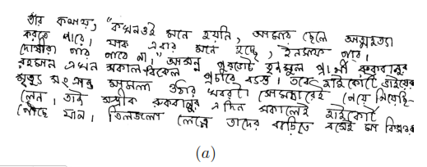
Previous Works(2)
Disadvantage
  A sample technique image in which the proposed method segmented the lines wrongly.

Slide 8
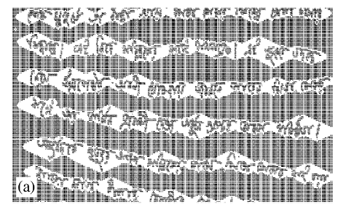
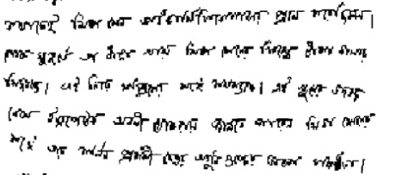
Previous Works(3)
Proposed Approach
  A flow of water in a particular direction across the image frame
  Water faces obstruction from characters of the text line and changes its flow angle

Slide 9

Previous Works(3)
Disadvantage
  In case of touching text lines ,problem occur in segmentation.

Slide 10
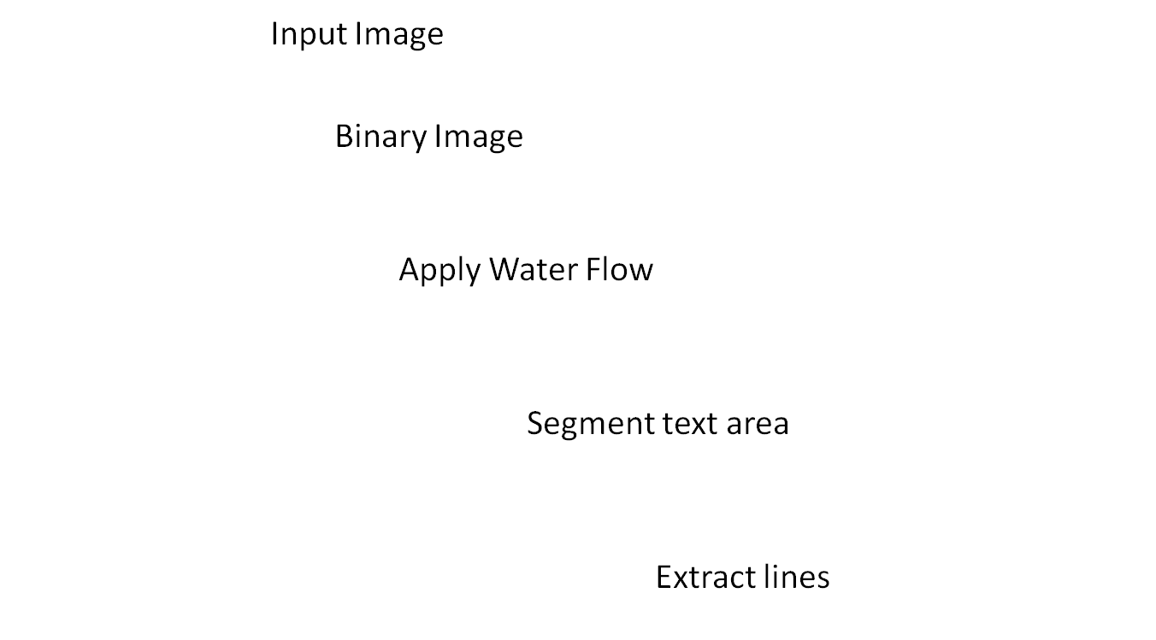
Proposed Idea

Slide 11
Future Scope
Using Convolution Neural Network for implementing this technique in advance way.
Create an OCR engine specilly for Bangla script.

Slide 12
References
U. Pal and S. Datta, "Segmentation of Bangla unconstrained handwritten text," Seventh International Conference on Document Analysis and Recognition, 2003. Proceedings., Edinburgh, UK, 2003, pp. 1128-1132.
doi: 10.1109/ICDAR.2003.1227832
S. Basu, C. Chaudhuri, M. Kundu, M. Nasipuri, D.K. Basu,Text “line extraction from multi-skewed handwritten documents” Pattern Recognition,Volume 40, Issue 6,2007, ISSN 0031-3203, https://doi.org/10.1016/j.patcog.2006.10.002.
K. Mullick, S. Banerjee and U. Bhattacharya, "An efficient line segmentation approach for handwritten Bangla document image," 2015 Eighth International Conference on Advances in Pattern Recognition (ICAPR), Kolkata, 2015, pp. 1-6. doi: 10.1109/ICAPR.2015.7050679
Jiang Yong and Chen Xiaojing, "Text line extraction from multi-skewed handwritten documents," 2008 27th Chinese Control Conference, Kunming, 2008, pp. 412-415.
doi: 10.1109/CHICC.2008.4604879
Brodic, Darko & Milivojevic, Zoran. (2011). “A New Approach to Water Flow Algorithm for Text Line Segmentation”. Journal of Universal Computer Science. 17. 30-47.

